Slide 1
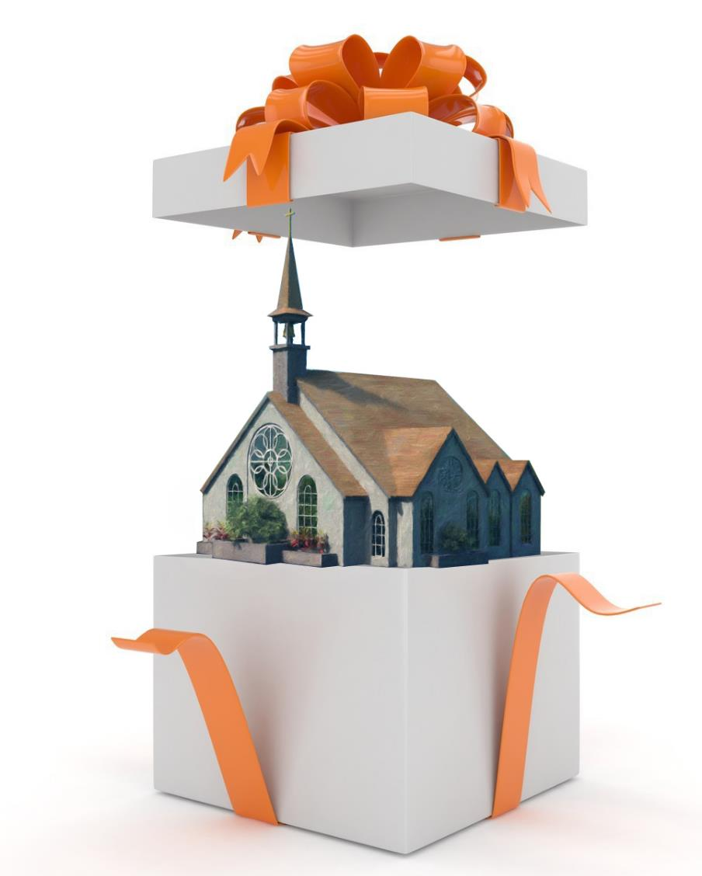

UNLIMITED POSSIBILITIES
Lesson 6 for August 8, 2020

Slide 2
Making Friends for God
The Joy of sharing His Mission
UNLIMITED POSSIBILITIES
About Spiritual Gifts
“But one and the same Spirit works all these things, distributing to each one individually as He wills”
(Corinthians 12:11 NKJV)

Slide 3

Heavenly intelligences are waiting to co-operate with human instrumentalities, that they may reveal to the world what human beings may become, and what, through union with the Divine, may be accomplished for the saving of souls that are ready to perish.
There is no limit to the usefulness of one who, putting self aside, makes room for the working of the Holy Spirit upon his heart and lives a life wholly consecrated to God.
All who consecrate body, soul, and spirit to His service will be constantly receiving a new endowment of physical, mental, and spiritual power. The inexhaustible supplies of heaven are at their command. Christ gives them the breath of His own Spirit, the life of His own life. The Holy Spirit puts forth its highest energies to work in mind and heart. Through the grace given us we may achieve victories that because of our own erroneous and preconceived opinions, our defects of character, our smallness of faith, have seemed impossible.
—Ellen G. White, Ministry of Healing 159.4. Compare DA 250-251.

Slide 4

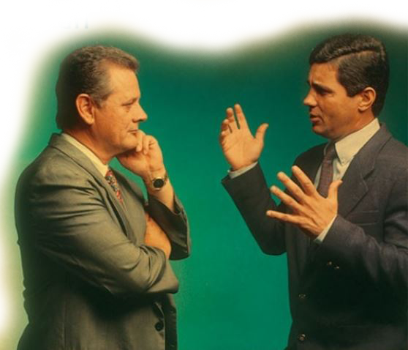





Jesus not only commissioned us to preach the Gospel throughout the world, but He also gave us gifts which empower us to fulfill that mission.
Spiritual gifts are divinely bestowed qualities given by the Holy Spirit specifically to build the body of Christ and enable believers to be effective witnesses in the world.
Who receives them?
Who gives them?
What is their purpose?
How can I know my gifts?
How can my gifts grow?

Slide 5


WHO RECEIVES THEM?
Paul compared the members of the Church to those of a human body. In this comparison, the Church is the body of Christ.
For as the body is one and has many members, but all the members of that one body, being many, are one body, so also is Christ. For by one Spirit we were all baptized into one body – whether Jews or Greeks, whether slaves or free – and have all been made to drink into one Spirit. For in fact the body is not one member but many. (1 Corinthians 12:12-14)
But now God has set the members, each one of them, in the body just as He pleased. And if they were all one member, where would the body be? But now indeed there are many members, yet one body. And the eye cannot say to the hand, "I have no need of you” nor again the head to the feet, “I have no need of you." No, much rather, those members of the body which seem to be weaker are necessary. (1 Corinthians 12:18-22)
And if one member suffers, all the members suffer with it; or if one member is honored, all the members rejoice with it. Now you are the body of Christ, and members individually. (1 Corinthians 12:26-27)

Slide 6

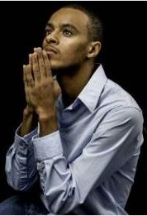
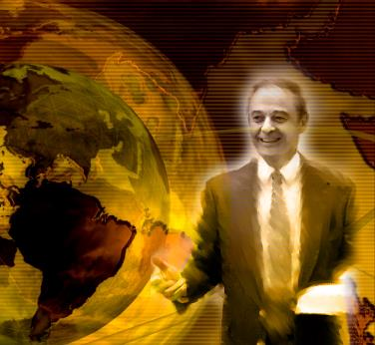
WHO RECEIVES THEM?
The hands, eyes, and lungs are quite different. Each member has unique characteristics and functions.
Likewise, each Church member is unique and has a unique set of gifts. All the members of the body have a purpose, and there are no Church members without gifts.
All have received at least one spiritual gift. We must work together to use those gifts to share the love and truth of Christ with the whole world.
There are no dispensable or useless members. Those preaching to crowds are as valuable as those praying silently.
Jon Paulien asked “Are you a toe nail, an elbow, or a brain cell?”

Slide 7

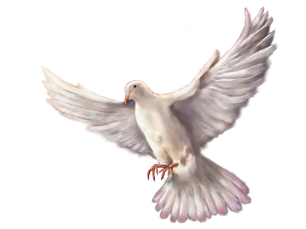
WHO GIVES THEM?
“But one and the same Spirit works all these things, distributing to each one individually as He wills.” (1 Corinthians 12:11)
The Bible explains that every perfect gift comes from God. The Holy Spirit is giving them as He considers best.
Every good gift and every perfect gift is from above, and comes down from the Father of lights, with whom there is no variation or shadow of turning. (James 1:17)
But to each one of us grace was given according to the measure of Christ's gift. (Ephesians 4:7)

Slide 8

WHO GIVES THEM?
“But one and the same Spirit works all these things, distributing to each one individually as He wills.” (1 Corinthians 12:11)
The Bible explains that every perfect gift comes from God. The Holy Spirit is giving them as He considers best.
Why can’t we choose our gifts?
Because we know too little about how we should fulfill the mission we’ve been given.
When we surrender our hearts to Jesus, God gives us the most appropriate gifts, so they can be used effectively to make the Church grow.
In addition to specific gifts, God also entrusts us with a specific work we must carry out in cooperation with others.

Slide 9

WHAT’S THEIR PURPOSE?
“for the equipping of the saints for the work of ministry, for the edifying of the body of Christ.” (Ephesians 4:12)
There are lists of gifts given to the first believers in Romans 12, 1 Corinthians 12 and Ephesians 4.
Having then gifts differing according to the grace that is given to us, let us use them:
if prophecy, let us prophesy in proportion to our faith;
or ministry, let us use it in our ministering;
he who teaches, in teaching;
he who exhorts, in exhortation;
he who gives, with liberality;
he who leads, with diligence;
he who shows mercy, with cheerfulness.
Let love be without hypocrisy.
Abhor what is evil. Cling to what is good.
Be kindly affectionate to one another with brotherly love,
in honour giving preference to one another;
not lagging in diligence,
fervent in spirit, serving the Lord;

Slide 10
WHAT’S THEIR PURPOSE?
rejoicing in hope,
patient in tribulation,
continuing steadfastly in prayer;
distributing to the needs of the saints,
given to hospitality.
Bless those who persecute you; bless and do not curse.
Rejoice with those who rejoice, and weep with those who weep.
Be of the same mind toward one another.
Do not set your mind on high things, but associate with the humble.
Do not be wise in your own opinion.
Repay no one evil for evil.
Have regard for good things in the sight of all men.
If it is possible, as much as depends on you, live peaceably with all men.
Beloved, do not avenge yourselves, but rather give place to wrath; . . .
Therefore “If your enemy is hungry, feed him; If he is thirsty, give him a drink; For in so doing you will heap coals of fire on his head.”
Do not be overcome by evil, but overcome evil with good.
(Romans 12:6-21)

Slide 11
WHAT’S THEIR PURPOSE?
But the manifestation of the Spirit is given to each one for the profit of all:
for to one is given the word of wisdom through the Spirit,
to another the word of knowledge through the same Spirit,
to another faith by the same Spirit,
to another gifts of healings by the same Spirit,
to another the working of miracles,
to another prophecy,
to another discerning of spirits,
to another different kinds of tongues,
to another the interpretation of tongues. (1 Corinthians 12:7-11)
God has appointed these in the church:
first apostles,
second prophets,
third teachers,
after that miracles,
then gifts of healings,
helps,
administrations,
varieties of tongues. (1 Corinthians 12:28)

Slide 12
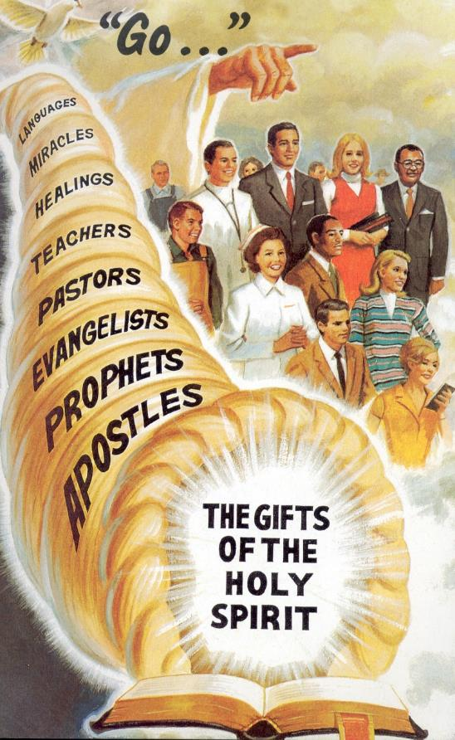
WHAT’S THEIR PURPOSE?
And He Himself gave some to be apostles,
some prophets,
some evangelists, and
some pastors and teachers,
(Ephesians 4:11)
Dr Hart in his notes stated:
There is a long chapter near the end of the book Christ’s Object Lessons (pages 325-365) in which Ellen White described a variety of talents. The talents that God revealed to Ellen White in the that book included: The Holy Spirit, mental faculties, speech, influence, time, health, strength, money, and kindly impulses and affections. Notice that none of these “talents” are the ones mentioned in the Bible!

Slide 13
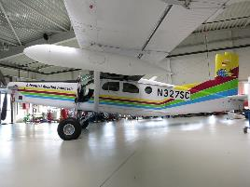
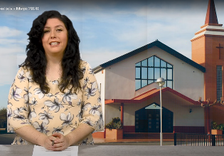

WHAT’S THEIR PURPOSE?
There are more gifts in addition to those first ones, like editing pictures and videos, piloting aircrafts, managing social networks…
Their purpose is to empower every believer to fulfill their function in the growth and nurture of the Church, so we can preach and serve the world.
Spiritual gifts are not natural talents. However, the Holy Spirit can sanctify natural talents and put them in service of Christ (becoming spiritual gifts).

Slide 14



HOW CAN I KNOW MY GIFTS?
“Therefore you do not lack any spiritual gift […]” (1 Corinthians 1:7 NIV)
We all have received gifts… which ones do you have?
The best way to find them out is to “get on with it”. Begin working in a ministry in your local church. That way you will find out if you have the right gifts for that work or not.
Let’s define some concepts:
Gifts: Special skills (e.g. teaching with ease)
Ministries: General fields of service (e.g. Sabbath School)
Activities: Specific events (e.g. leading a Sabbath School class)
If you already know your gift, you will find the right ministry or activity for yourself easily.
If you feel comfortable in a specific ministry, you can discover your gifts in that area and the best activities for your gifts.
If you do a specific activity well, you will find your gifts and the right ministry for you as you work in that activity.
Gifts
Ministries
Activities

Slide 15
HOW CAN I KNOW MY GIFTS?
How do you discover the spiritual gifts in your life?
Jon Paulien gave these answers
Do you like it?
Are you good at it? Are there good results?
Does the church confirm you are good at it?

Slide 16
SPIRITUAL GIFTS - TALENTS
Spiritual gifts (see 1 Cor. 12:4–6) are qualities that God imparts so we can serve Him effectively. Ministries are the general areas we can express our gifts in, and activities are the specific events that allow us to use our gifts. Spiritual gifts do not come fully developed. As the Holy Spirit impresses you with some area of service, pray that He will lead you to a specific ministry to exercise your gift through an outreach activity. Lesson Wednesday
Of course, all our abilities, whether we are believers or unbelievers, come from God. Every talent we have is God-given. Spiritual gifts, however, are different from natural talents in two distinct ways. First, they differ from natural talents in the way they are used and, second, where they are used. The motivation for natural talents may be self-glory. The motivation in using spiritual gifts is always God’s glory. Natural talents are often used to advance one’s standing in the world. Spiritual gifts are unselfishly used to bless and expand God’s church. Teacher’s notes
Spiritual gifts are for witness and service.

Slide 17

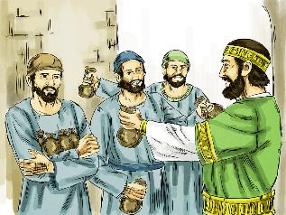
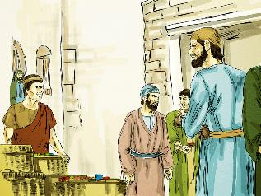
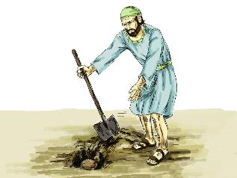
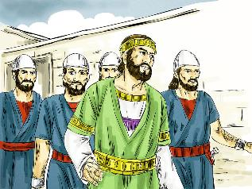
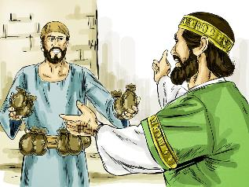
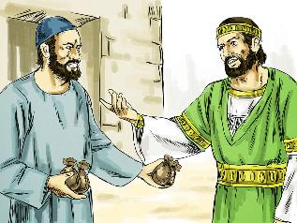
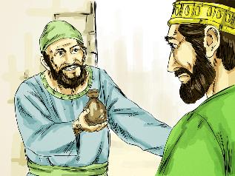
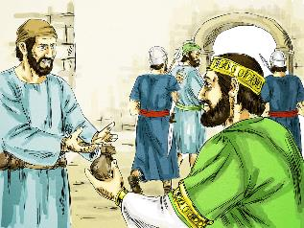
HOW CAN MY GIFTS GROW?
“For to everyone who has, more will be given, and he will have abundance; but from him who does not have, even what he has will be taken away.” (Matthew 25:29)
In the parable of the talents, Jesus explained that everyone receives gifts, but some people receive more than others
(Matthew 25:14-30).
However, that’s the starting point only. We can “negotiate” with our initial gifts.
They will grow as we use them, and we may also receive new gifts. Be careful, as we may lose our gifts if we don’t use them.
Ask God to show you which gifts He’s given you and how you can best use them. It doesn’t matter how many gifts you’ve received, but what you do with them.

Slide 18

“To His servants Christ commits ‘His goods’—something to be put to use for Him. He gives ‘to every man his work.’ Each has his place in the eternal plan of heaven. Each is to work in co-operation with Christ for the salvation of souls. Not more surely is the place prepared for us in the heavenly mansions than is the special place designated on earth where we are to work for God.”
E.G.W. (Christ’s Object Lessons, cp. 25, p. 326)

Slide 19

The End
These slides have been adapted from those prepared by Sergio Fustero and Eunice Laveda, members of the Seventh-Day Adventist Church in Spain.
The originals can be found at https://www.fustero.es/index_en.php

