Slide 1
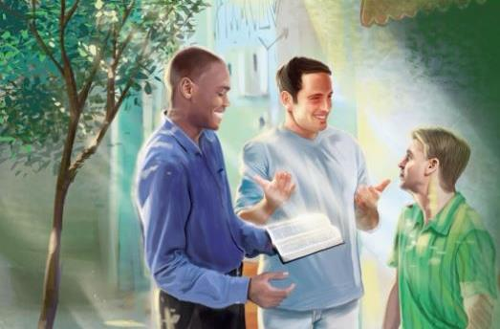
Lesson 7 for August 15, 2020
Making Friends for God
The Joy of sharing His Mission
SHARING THE WORD

Slide 2

For as the rain comes down, and the snow from heaven, And do not return there, But water the earth, And make it bring forth and bud, That it may give seed to the sower And bread to the eater, (verse 10)
“‘So shall My word be that goes forth from My mouth; it shall not return to Me void, but it shall accomplish what I please, and it shall prosper in the thing for which I sent it’” (Isaiah 55:11 NKJV)

Slide 3
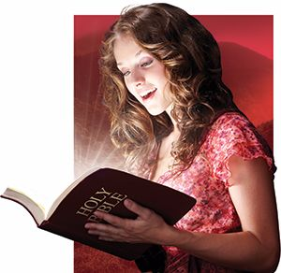
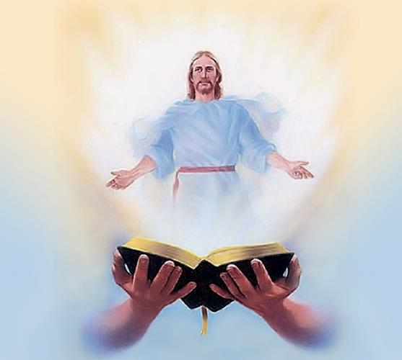






Jesus said: “You search the Scriptures, for in them you think you have eternal life; and these are they which testify of Me.” (John 5:39)
Jesus is the main theme throughout the Bible. That’s why it is so powerful. God has shown Himself to humanity through different means, and the Bible is the most characteristic.
It is not a book to be just read, but to be “eaten”. We must let the Scriptures fill our minds, transform us, and gives us power to share its main theme with others; that is, the love and character of Jesus.
What does the Bible say about itself?
  Symbols of God’s Word
  Its creating power
What can we do with it?
  Making the most of its benefits
  Believing in its promises
  Sharing it

Slide 4


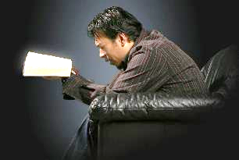

Symbols of God’s Word
“Your word is a lamp for my feet, a light on my path.” (Psalm 119:105 NIV)
The Bible is compared to various symbols that show its qualities.
Psalm 119:105
Jeremiah 23:29
Jeremiah 23:29
Luke 8:11
Matthew 4:4
Light
Fire
Hammer
Seed
Bread
The dark minds are lighted up
It consumes the slag of our sin
It breaks our tough hearts
It plants life in us that brings fruit for the Kingdom of God
It satisfies the hunger of our soul and nourishes our spirit
When we study the Word, our lives are transformed by His goodness, charmed by His love, amazed at His grace, and satisfied in His presence.

Slide 5
Symbols of God’s Word
Your word is a lamp to my feet And a light to my path. (Psalm 119:115)
“Is not My word like a fire?” says the Lord,(Jeremiah 23:29)
“And like a hammer that breaks the rock in pieces?” (Jeremiah 23:29)
Now the parable is this: “The seed is the word of God.” (Luke 8:11)
But He answered and said, “It is written, ‘Man shall not live by bread alone, but by every word that proceeds from the mouth of God.’ ” (Matthew 4:4)
What would be modern symbols?
Mobile Phone
GPS device

Slide 6

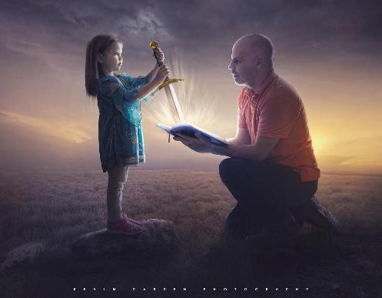
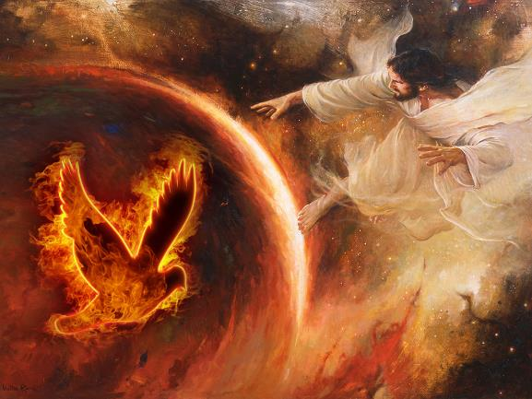

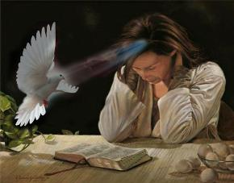
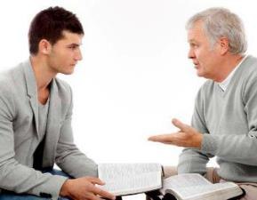
ITS CREATING POWER
For the word of God is living and powerful, and sharper than any two-edged sword, piercing even to the division of soul and spirit, and of joints and marrow, and is a discerner of the thoughts and intents of the heart. (Hebrews 4:12)
By the word of the Lord the heavens were made, And all the host of them by the breath of His mouth. (Psalm 33:6)
The same power of God’s creating Word is found in His written Word, the Bible. The same Spirit that worked in Creation inspired the Scriptures.
The Holy Spirit can make a new creation from us. We just need to let Him work in our lives as we read the Bible.
The Holy Spirit will also change other people’s lives when we help them to understand the Scriptures.

Slide 7

“The creative energy that called the worlds into existence is in the word of God. This word imparts power; it begets life. Every command is a promise; accepted by the will, received into the soul, it brings with it the life of the Infinite One. It transforms the nature and recreates the soul in the image of God”.
— Ellen G. White, Education, p. 126

Slide 8

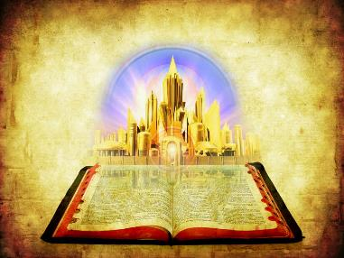
MAKING THE MOST OF ITS BENEFITS
“All Scripture is given by inspiration of God, and is profitable for doctrine, for reproof, for correction, for instruction in righteousness.” (2 Timothy 3:16)
The Bible is full of benefits for our lives. Let’s check some of them.
2 Peter 1:4. It makes us partakers of the divine nature
[His Divine Power] by which have been given to us exceedingly great and precious promises, that through these you may be partakers of the divine nature, having escaped the corruption that is in the world through lust. (2 Peter 1:4)

Slide 9
MAKING THE MOST OF ITS BENEFITS
“All Scripture is given by inspiration of God, and is profitable for doctrine, for reproof, for correction, for instruction in righteousness.” (2 Timothy 3:16)
The Bible is full of benefits for our lives. Let’s check some of them.
2 Peter 1:4. It makes us partakers of the divine nature
James 1:21. It saves our souls
Therefore lay aside all filthiness and overflow of wickedness, and receive with meekness the implanted word, which is able to save your souls. (James 1:21)

Slide 10
MAKING THE MOST OF ITS BENEFITS
“All Scripture is given by inspiration of God, and is profitable for doctrine, for reproof, for correction, for instruction in righteousness.” (2 Timothy 3:16)
The Bible is full of benefits for our lives. Let’s check some of them.
2 Peter 1:4. It makes us partakers of the divine nature
James 1:21. It saves our souls
Acts 20:32. It gives us an inheritance among the sanctified
“So now, brethren, I commend you to God and to the word of His grace, which is able to build you up and give you an inheritance among all those who are sanctified.” (Acts 20:32)

Slide 11
MAKING THE MOST OF ITS BENEFITS
“All Scripture is given by inspiration of God, and is profitable for doctrine, for reproof, for correction, for instruction in righteousness.” (2 Timothy 3:16)
The Bible is full of benefits for our lives. Let’s check some of them.
2 Peter 1:4. It makes us partakers of the divine nature
James 1:21. It saves our souls
Acts 20:32. It gives us an inheritance among the sanctified
2 Timothy 3:15, 17. It makes us wise, perfect, and ready for every good work
From childhood you have known the Holy Scriptures, which are able to make you wise for salvation through faith which is in Christ Jesus.
That the man of God may be complete, thoroughly equipped for every good work. (2 Timothy 3:15, 17)

Slide 12




MAKING THE MOST OF ITS BENEFITS
“All Scripture is given by inspiration of God, and is profitable for doctrine, for reproof, for correction, for instruction in righteousness.” (2 Timothy 3:16)
The Bible is full of benefits for our lives. Let’s check some of them.
2 Peter 1:4. It makes us partakers of the divine nature
James 1:21. It saves our souls
Acts 20:32. It gives us an inheritance among the sanctified
2 Timothy 3:15, 17. It makes us wise, perfect, and ready for every good work
2 Timothy 3:16.
  Doctrine. It reveals the truth and points falsehood out
  Reproof. It exposes our sins
  Correction. It changes our mistakes
  Instruction. It reveals Christ’s righteousness

Slide 13

The truths of the Bible, treasured in the heart and mind and obeyed in the life, convince and convert the soul, transform the character, and comfort and uplift the heart.
- E G White - TMK 199.2

Slide 14

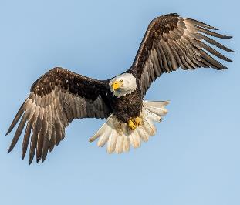
BELIEVING IN ITS PROMISES
“And my God shall supply all your need according to His riches in glory by Christ Jesus.” (Philippians 4:19)
Isaiah 40:31
There are more than 3,000 promises in the Bible. God’s has committed to fulfill each one of them in our lives, and He encourages us to claim them.
But those who wait on the Lord Shall renew their strength; They shall mount up with wings like eagles, They shall run and not be weary, They shall walk and not faint, (Isaiah 40:31)

Slide 15
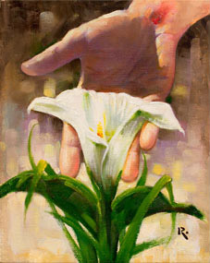
BELIEVING IN ITS PROMISES
“And my God shall supply all your need according to His riches in glory by Christ Jesus.” (Philippians 4:19)
Isaías 40:31
There are more than 3,000 promises in the Bible. God’s has committed to fulfill each one of them in our lives, and He encourages us to claim them.
Luke 12:27-28
Consider the lilies, how they grow: they neither toil nor spin; and yet I say to you, even Solomon in all his glory was not arrayed like one of these. If then God so clothes the grass, which today is in the field and tomorrow is thrown into the oven, how much more will He clothe you, O you of little faith? (Luke 12:27-28)

Slide 16
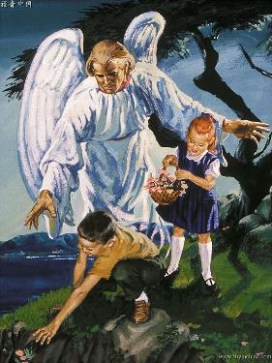
BELIEVING IN ITS PROMISES
“And my God shall supply all your need according to His riches in glory by Christ Jesus.” (Philippians 4:19)
Isaías 40:31
There are more than 3,000 promises in the Bible. God’s has committed to fulfill each one of them in our lives, and He encourages us to claim them.
Luke 12:27-28
For He shall give His angels charge over you, To keep you in all your ways. (Psalm 91:11)
Psalm 91:11

Slide 17
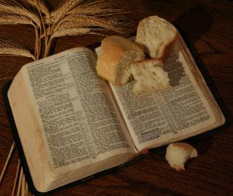
BELIEVING IN ITS PROMISES
“And my God shall supply all your need according to His riches in glory by Christ Jesus.” (Philippians 4:19)
Isaías 40:31
There are more than 3,000 promises in the Bible. God’s has committed to fulfill each one of them in our lives, and He encourages us to claim them.
Luke 12:27-28
Isaiah 33:16
[He who walks righteously and speaks uprightly] will dwell on high; His place of defense will be the fortress of rocks; Bread will be given him, His water will be sure. (Isaiah 33:16)
Psalm 91:11

Slide 18
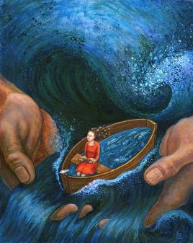
BELIEVING IN ITS PROMISES
“And my God shall supply all your need according to His riches in glory by Christ Jesus.” (Philippians 4:19)
Isaías 40:31
There are more than 3,000 promises in the Bible. God’s has committed to fulfill each one of them in our lives, and He encourages us to claim them.
Luke 12:27-28
Isaiah 33:16
When you pass through the waters, I will be with you; And through the rivers, they shall not overflow you. When you walk through the fire, you shall not be burned, Nor shall the flame scorch you. (Isaiah 43:2)
Isaiah 43:2
Psalm 91:11

Slide 19

BELIEVING IN ITS PROMISES
“And my God shall supply all your need according to His riches in glory by Christ Jesus.” (Philippians 4:19)
Isaías 40:31
There are more than 3,000 promises in the Bible. God’s has committed to fulfill each one of them in our lives, and He encourages us to claim them.
Luke 12:27-28
Isaiah 33:16
Isaiah 43:2
Psalm 4:8
For He shall give His angels charge over you, To keep you in all your ways. (Psalm 4:8)
Psalm 91:11

Slide 20
BELIEVING IN ITS PROMISES
“And my God shall supply all your need according to His riches in glory by Christ Jesus.” (Philippians 4:19)
Isaías 40:31
There are more than 3,000 promises in the Bible. God’s has committed to fulfill each one of them in our lives, and He encourages us to claim them.
They confirm that God cares for our physical and spiritual needs. On the day we’ll meet Him face to face, we will state: “There has not failed one word of all His good promise, which He promised.” (1Kings 8:56)
However, His promises are not unconditional. The lack of faith may annul them.
Luke 12:27-28
Isaiah 33:16
Isaiah 43:2
For indeed the gospel was preached to us as well as to them; but the word which they heard did not profit them, not being mixed with faith in those who heard it. (Hebrews 4:2)
Psalm 4:8
Psalm 91:11

Slide 21
BELIEVING IN ITS PROMISES
“And my God shall supply all your need according to His riches in glory by Christ Jesus.” (Philippians 4:19)
Isaías 40:31
There are more than 3,000 promises in the Bible. God’s has committed to fulfill each one of them in our lives, and He encourages us to claim them.
They confirm that God cares for our physical and spiritual needs. On the day we’ll meet Him face to face, we will state: “There has not failed one word of all His good promise, which He promised.” (1Kings 8:56)
However, His promises are not unconditional. The lack of faith may annul them.
Luke 12:27-28
Isaiah 33:16
Isaiah 43:2
Psalm 4:8
The blessings of God’s promises become ours when we proclaim them by faith and believe they’re true because Christ is always faithful.
Psalm 91:11

Slide 22

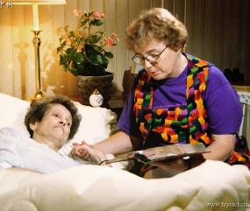

SHARING IT
“The Lord God has given Me the tongue of the learned, that I should know how to speak a word in season to him who is weary. He awakens Me morning by morning, He awakens My ear to hear as the learned.” (Isaiah 50:4)
God “awakens” our ears and gives us wisdom when we study the Bible in a daily basis.
He also gives us “tongue of the learned” so we can share the good news with others.
The Word of God cannot be locked up in our hearts. The joy of salvation moves us to make the most of every chance to share its message with those that don’t know about it.
Paul commanded us the following: “Preach the word; be prepared in season and out of season; correct, rebuke and encourage—with great patience and careful instruction.” (2Tim. 4:2 NIV)

Slide 23

To me, it is absolutely amazing that a book written two thousand years ago should have such relevance to the institution of the family as it exists in our modern capitalistic society. Anyone who reads through the New Testament will be amazed at how its message spells out patterns for interpersonal relationships within the context of the family.
Tony Campolo - Let me tell you a story - chapter on the family.

Slide 24

The End
These slides have been adapted from those prepared by Sergio Fustero and Eunice Laveda, members of the Seventh-Day Adventist Church in Spain.
The originals can be found at https://www.fustero.es/index_en.php

